Slide 1
(Let’s do a git pull request, and then everyone pull my edits)
Status:
Have a general .stan code that will accommodate simple/multiple regression for J0 and b as a function of input variables
Have done some expanding and QA/QC with the dataset:
Use a new Location x Month x Year ID (too much cross-profile variability)
Added climatological surface nutrient, subsurface temperature and oxygen, cell size
Removed traps deployed longer than a month
Removed
Environmental variables are available for: Location x Month x Year (_mon_yr), Location x Month (_mon), Location (_id)
Satellite SST, NPP (despite missing values), only available for Location x Month for subsurface O2, T, surface phosphate, cell size.
Plan:
Everyone choose a variable, or two, and fit the model, analyze results:
Fit the global model and fit to individual ocean regions
Show results in two weeks
Variables: Net primary productivity, sea surface temperature, surface nutrient concentration, mineral ballast, phytoplankton cell size, subsurface temperature, subsurface oxygen
Then we’ll compare the fits via model selection analysis and write a paper about the empirical evidence for drivers of organic matter flux
I’ve started a Word manuscript in the GitHub repo (take a look)

Slide 2
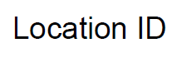
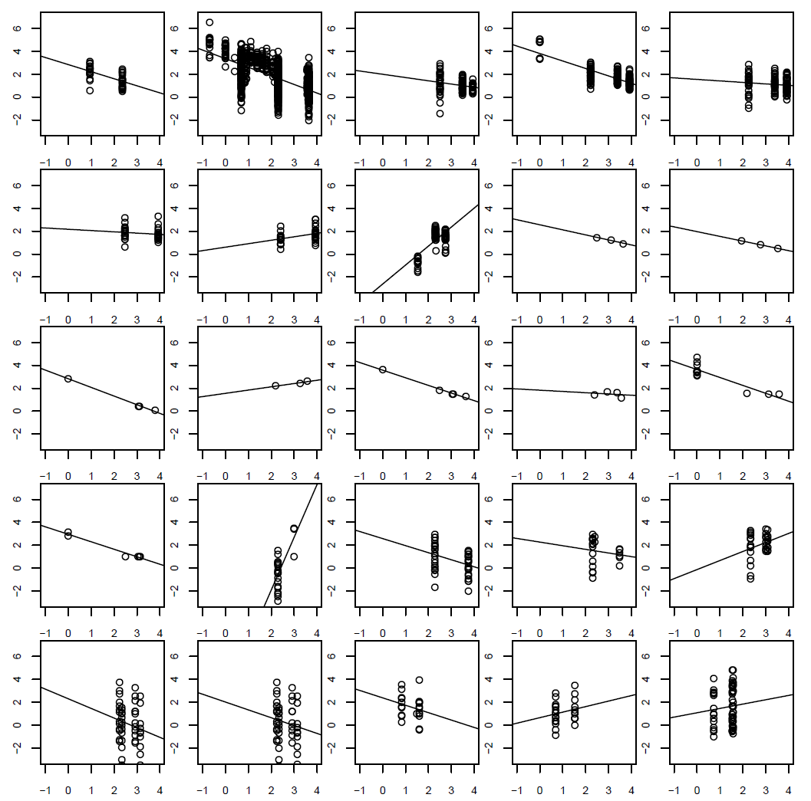
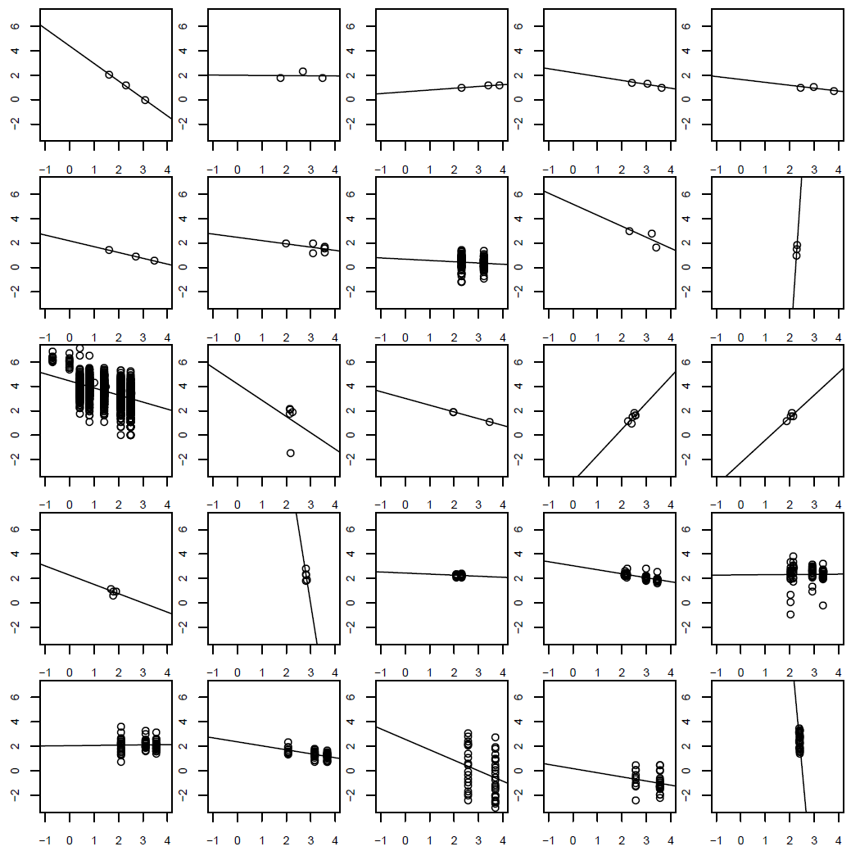
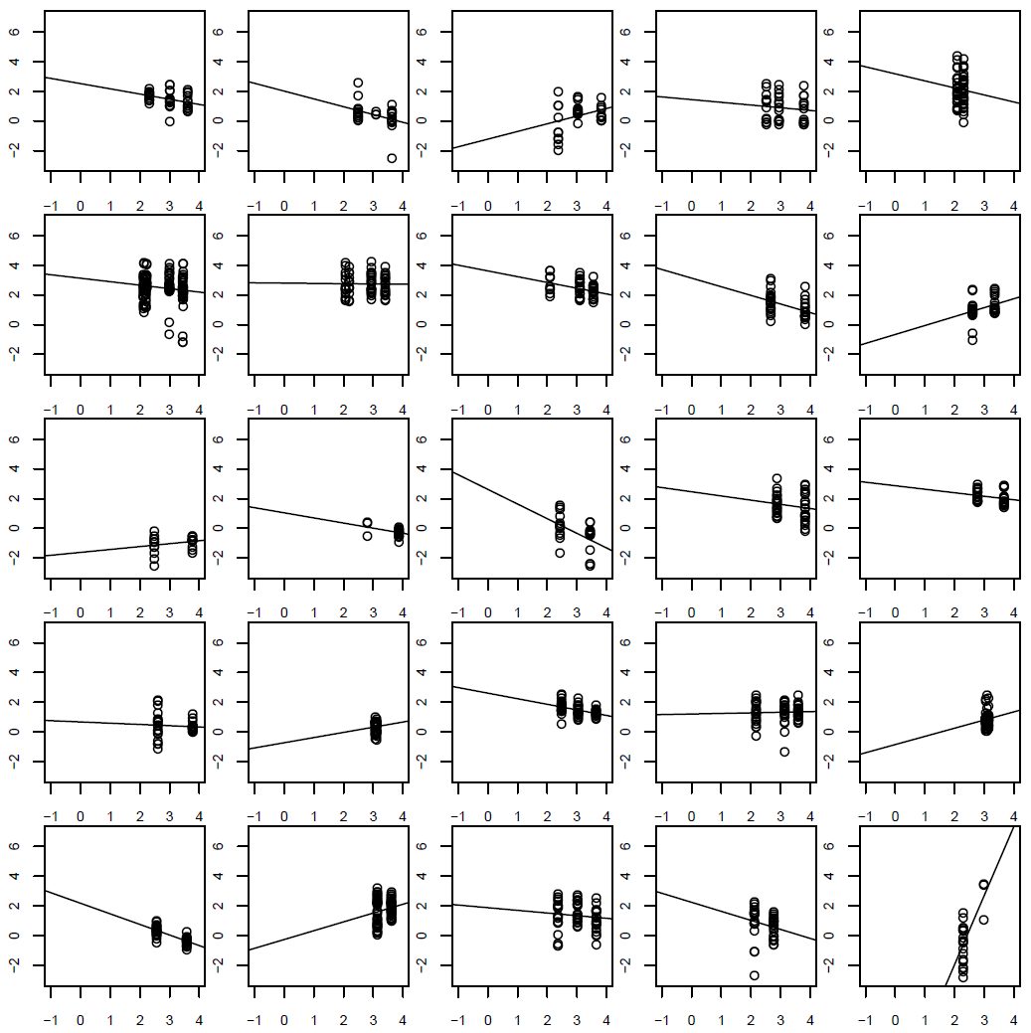
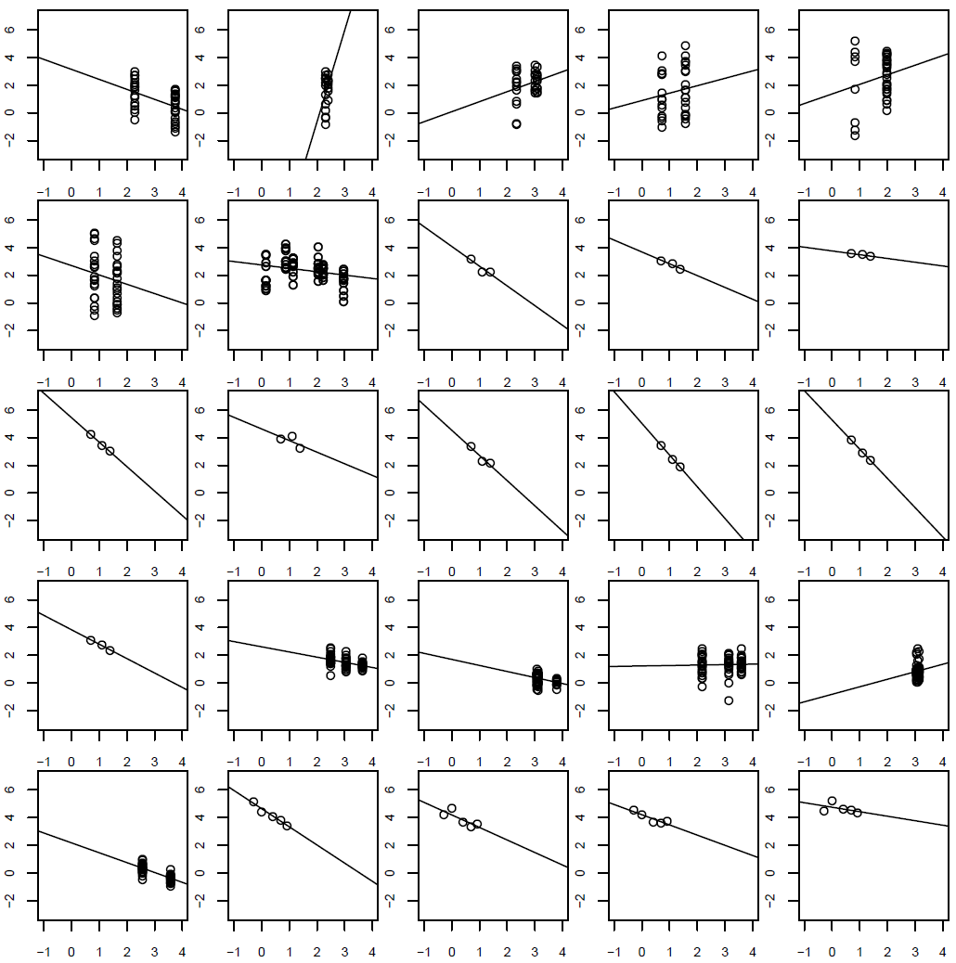
Stations 1-100 of 562

Slide 3
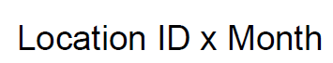
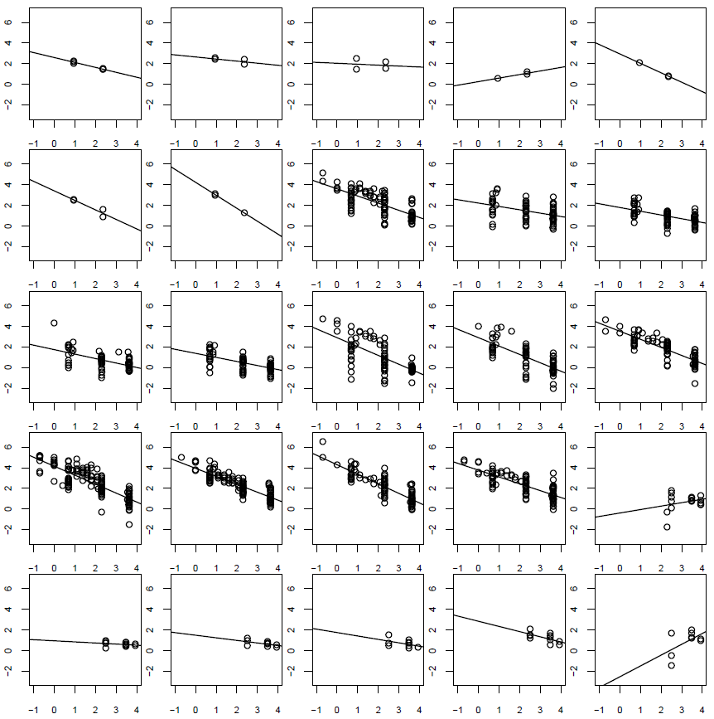
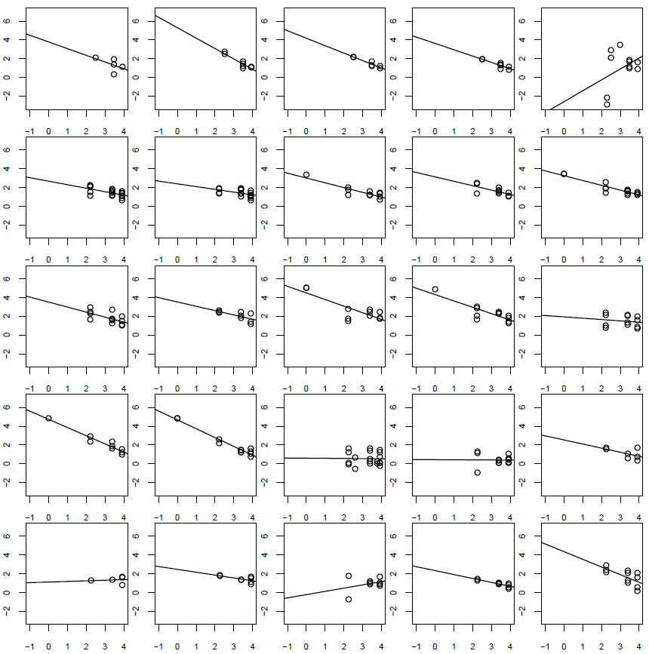
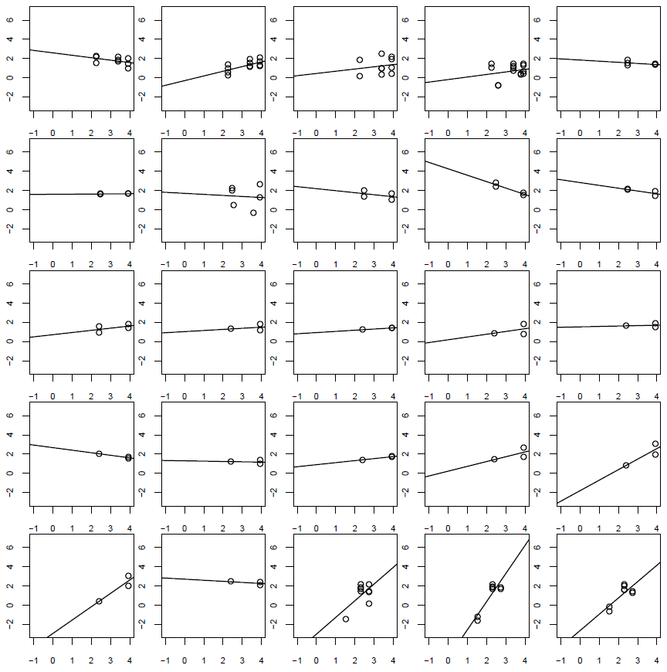
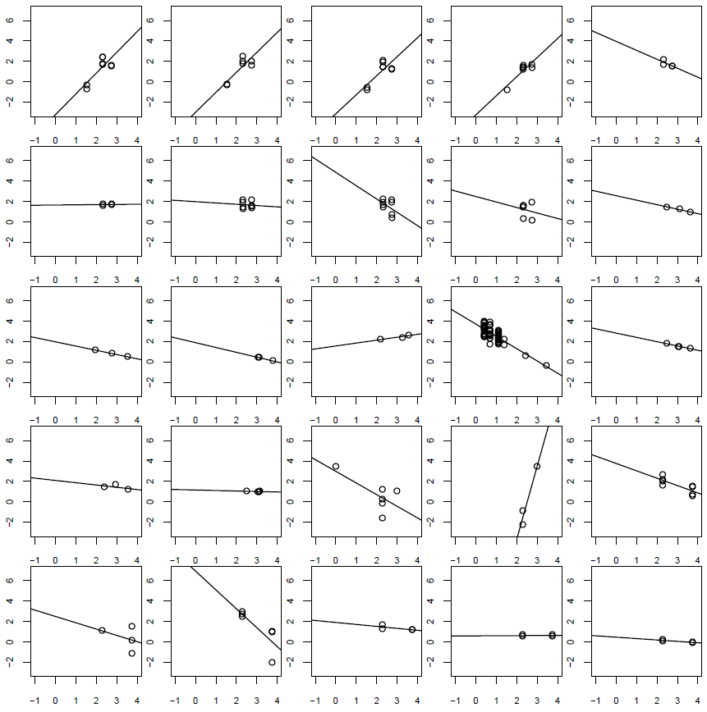
Stations 1-100 of 2040

Slide 4
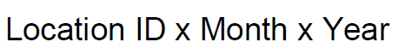
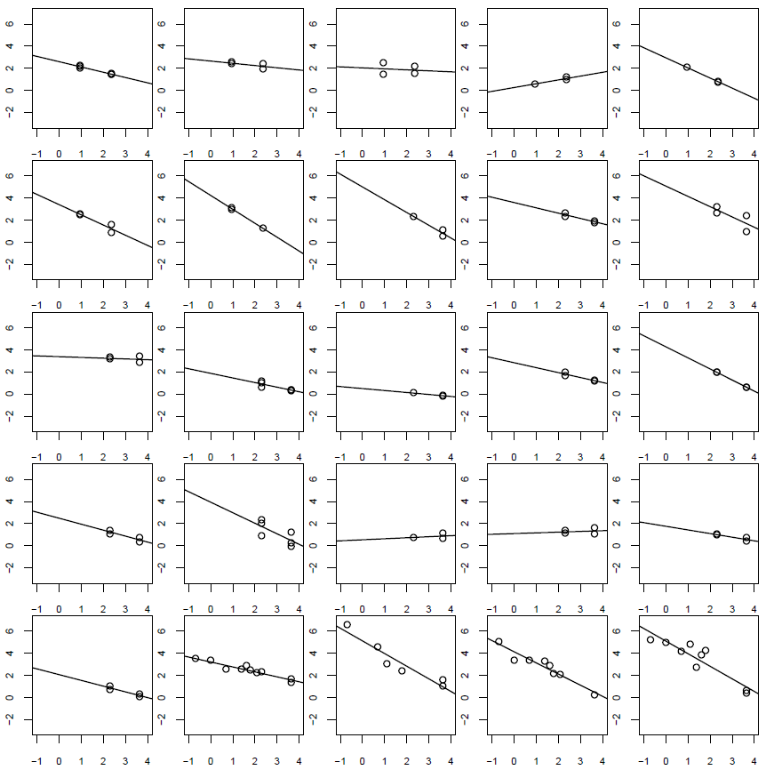
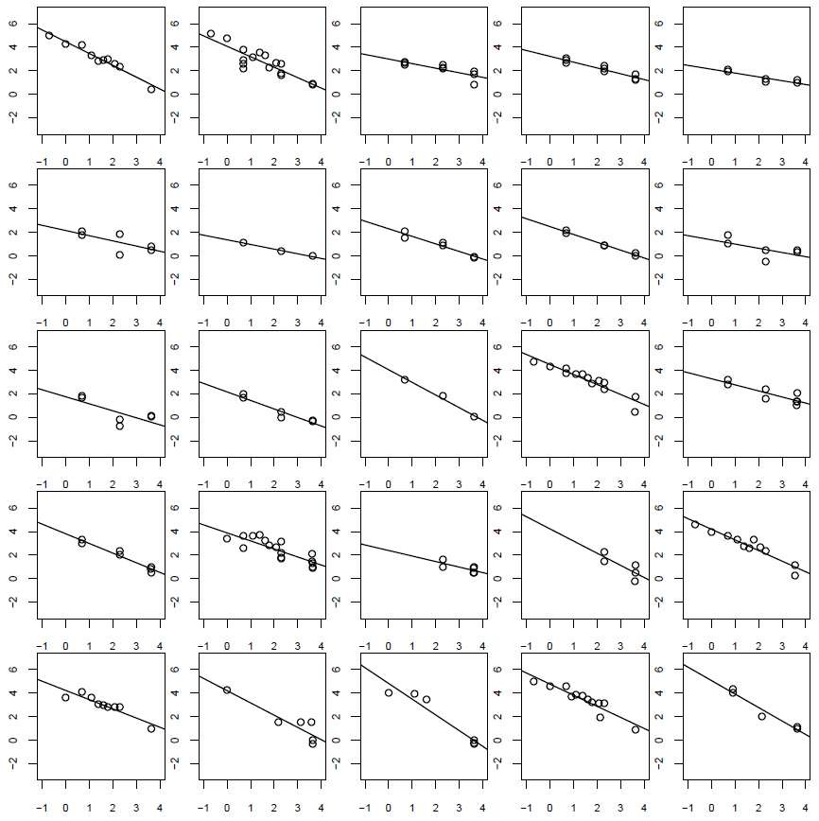
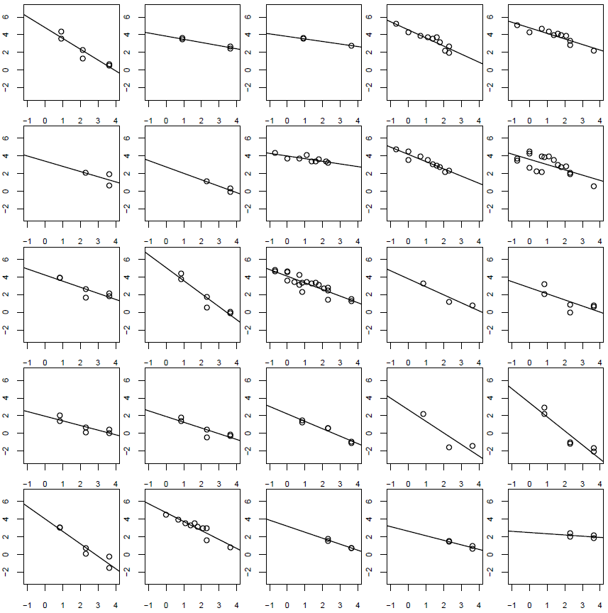
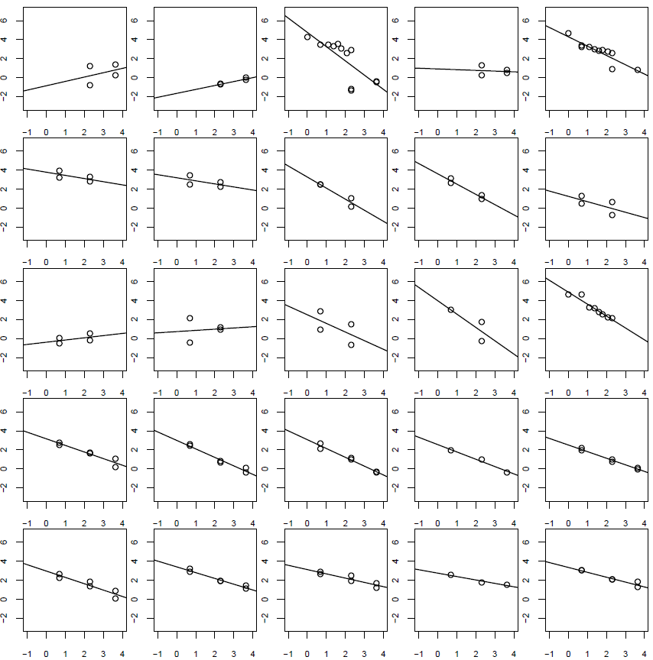
Stations 1-100 of 3344

Slide 5
Tips for analysis (see previous codes)
Plots to make:
Histograms of parameters with uncertainty intervals
Watch out for:
Use station ID according to id_mon_yr
Steps to analysis
Construct two design matrices, one for J0, one for b; remember the design matrix contains the environmental variables as columns and a column of all ones
They both should contain the same number of rows and no NAs (take a new subset of the data for each model; subset columns first, then remove NAs, because each environmental variable will have different number of NAs)
Feed x, y, and design matrices to Stan, along with info Re: # of variables, etc.
Make some plots

Slide 6
Variable Sign-Up
Net primary productivity: Benoit
Sea surface temperature: Weilei
Surface nutrient concentration: Megha, Mariam
Mineral ballast: Louis & Francois
Phytoplankton cell size: Cathy?
Subsurface temperature: Greg
Subsurface oxygen: Greg
Additional function .stan file: Yara Greg: add silicic acid

